Slide 1
The Sociology of U.S. History James W. Loewen
jloewen@uvm.edu

Slide 3
The Sociology of U.S. History James W. Loewen
jloewen@uvm.edu

Slide 4
Essence of sociology:
Social structure pushes people around,
determines their careers.
and even affects how they think.
Upper-middle class students can be soclexic.
One answer: get them involved in social change.

Slide 5
After George Floyd, we must act. I suggest four key areas:
How U.S. History is taught.
Local public history.
Sundown towns.
4. Teacher expectations and
“standardized tests”

Slide 6
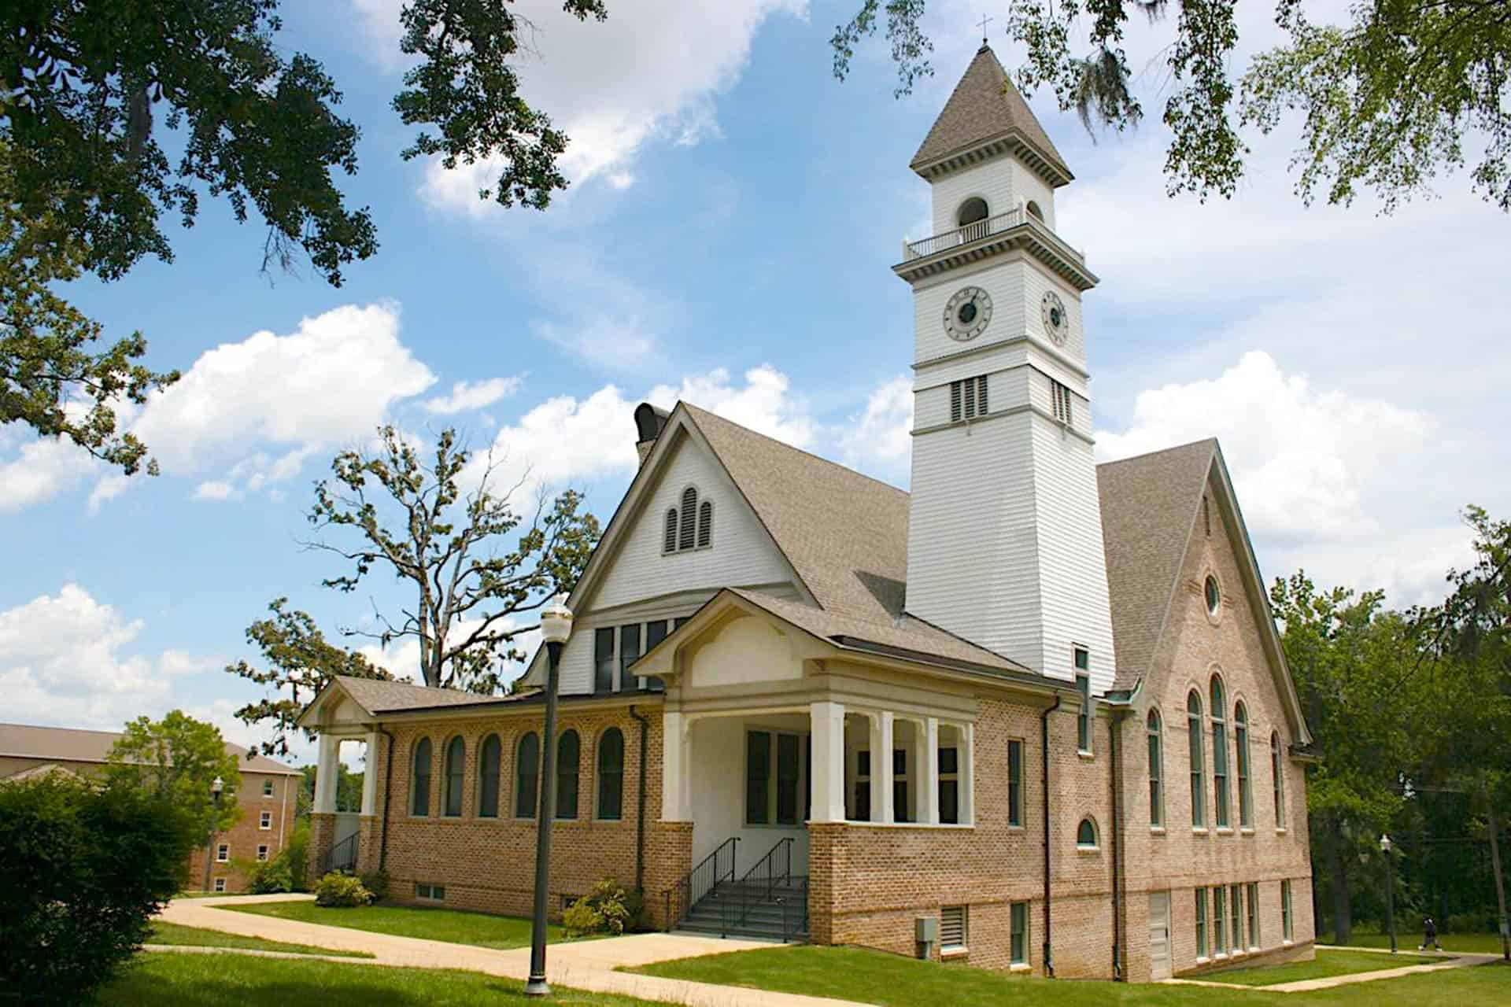

Slide 7
What was Reconstruction?
The period after the Civil War,
when Blacks took over
the Southern states,
but they were too soon out of slavery, so they screwed up,
and white folks had to
take control again.

Slide 8
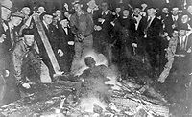
But that happened, didn’t it?
Didn’t Mississippi have more lynchings
Than any other state?

Slide 9
(What’s wrong with this photo?)

Slide 10
“I really like your book. I’ve been using it to heckle my teacher from the back of the room.”

Slide 11
Why did we have a Civil War?
or, better put,
Why did the South secede?

Slide 12
Alternatives:
Slavery
States’ Rights
the Election of Lincoln
Tariffs and Taxes (issues about)

Slide 13
Results Nationwide

Slide 14
How could this happen??
When did it happen?
The Nadir: 1890-1940
What was its purpose?
Rationalize and defend the South
Why did the North acquiesce?
Unclean hands: complicit in white supremacy

Slide 15
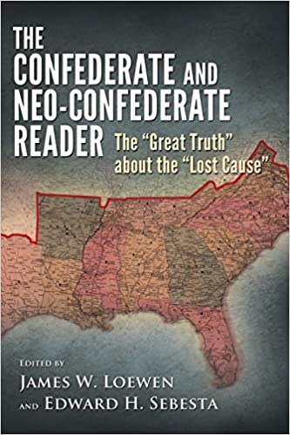

Slide 16
Governor. of TN, “Message to Legislature,” 1/7/1861
-- The systematic, wanton, and long-continued agitation of the slavery question.
-- [The Republican Party] has, in the person of the President-elect, asserted the equality of the black with the white race.

Slide 17
Sociology of Knowledge re Confederate Monuments:
Went up during Nadir of race relations (1890-1940)
Went up near center of power or symbolic center of the community
Asserted bad history (“Deo Vindice,” “States Rights,” etc.)
Implicitly and often explicitly proclaimed white supremacy.

Slide 19
My “signature”
"Telling the truth about the past helps cause justice in the present.
Achieving justice in the present helps us tell the truth about the past."

Slide 20
Sundown Towns, a product of the Nadir
Rare in the South, but common in Tennessee, except west Tennessee.
Also common in north Alabama, especially on Sand Mountain, and throughout NW Arkansas.
In GA, a V-shape of counties from Forsyth to the south to the state line NW and NE.
Also in far western NC and Virginia.
Some sundown suburbs briefly around Birmingham, Jackson, New Orleans, etc.
Beach communities too.

Slide 21
What to do about Sundown Towns
“Out” them: wikipedia, my website, etc.
Get them to change: 3-step program
1. Admit it. [“We did this.”]
2. Apologize. [“and it was wrong, and
we’re sorry.”]
3. Change. [“and we don’t do it any more.”]
(See my website for examples.)

Slide 22
Teacher Expectations and “Standardized” Tests

Slide 23
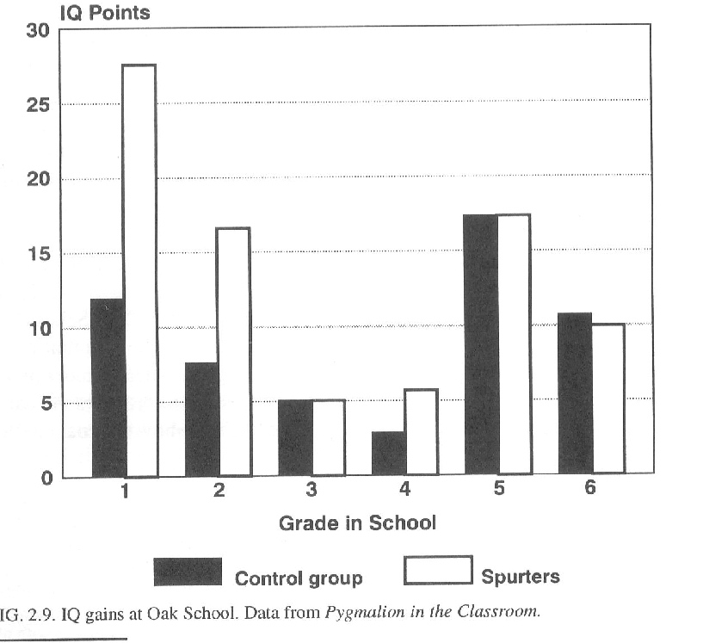

Slide 24
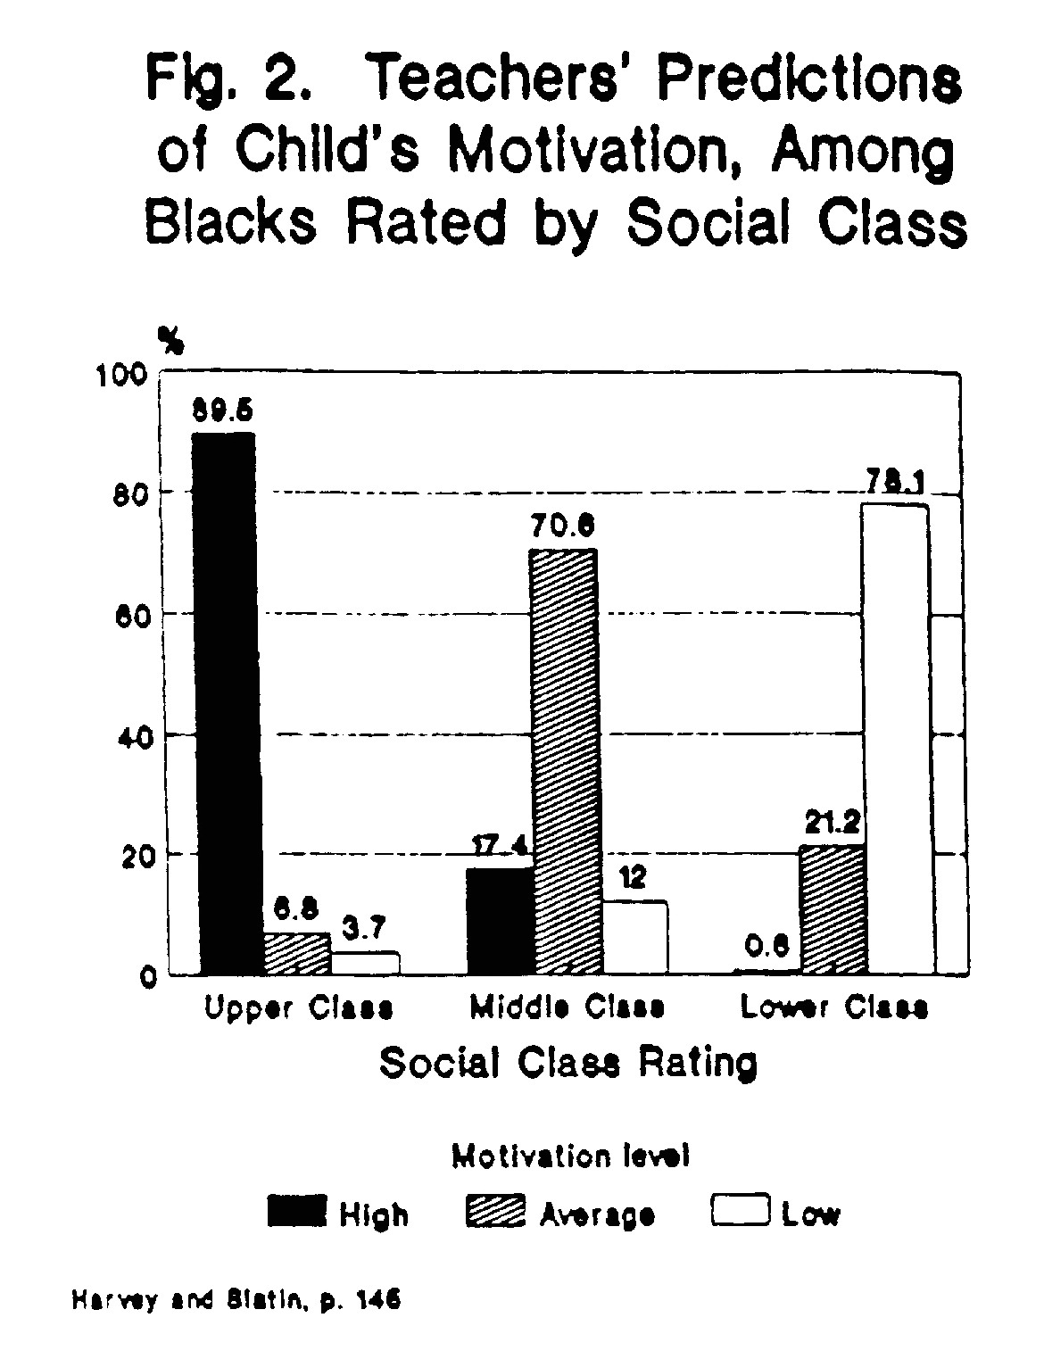

Slide 25
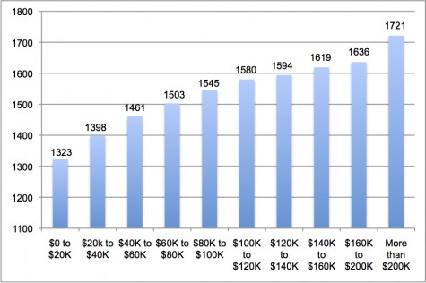
SAT scores (600-2400 range) by family income

Slide 26
Action to take about the ACT/SAT:
Get your students to understand the biases in the ACT and SAT.
Then help them make the case
hto go test blind.

Slide 27
With action components, your classes will be points of inspiration in our post-George Floyd Times

